Slide 1

Project Review
Batch: 2022-26
Date: 21.11.2025
DEPARTMENT OF ELECTRONICS AND COMMUNICATION ENGINEERING
SCHOOL OF ENGINEERING AND TECHNOLOGY
GANDHI INSTITUTE OF ENGINEERING AND TECHNOLOGY UNIVERSITY, ODISHA, GUNUPUR
(GIET UNIVERSITY)

Slide 2
Project Details
Project Title: CMOS-Based 2:1 Multiplexer with XOR Gate for Fault-Detection
Team Members:
1. Tutika Durga Prasad (22UG011335)
2. Tamada Lallu Kumar (22UG011337)
3. Ponnitivalasa Devraj (22UG011329)
4. Subham Satapathy(22UG011342)
Guide: Dr. Jitendra Kumar

Slide 3
Problem Statement & Objectives
Problem Statement:
The project aims to develop a CMOS-based 2:1 multiplexer integrated with an XOR gate that enhances real-time fault detection capabilities in modern computing systems. Traditional multiplexers lack built-in fault detection, which risks undetected errors particularly in critical and high-reliability systems like AI processors and quantum computing. The use of an XOR gate for comparing expected and actual outputs enables immediate detection of faults in multiplexer selections, improving reliability, signal integrity, and fault tolerance while maintaining low power and high speed with 90nm CMOS technology.
Objectives:
1. Design and implement a CMOS 2:1 multiplexer using transmission gates
composed of complementary PMOS and NMOS transistors to ensure full
voltage swing and low power consumption.
2. Integrate an XOR gate to serve both as a signal selector and real-time fault
detector by comparing expected and actual outputs for error indication.
3. Achieve a design optimized for scalability and integration in fault-tolerant
systems, particularly targeting AI hardware, quantum computing, FPGA
systems, and low-power VLSI designs.
Problem Statement: The project aims to develop a CMOS-based 2:1 multiplexer integrated with an XOR gate that enhances real-time fault detection capabilities in modern computing systems. Traditional multiplexers lack built-in fault detection, which risks undetected errors particularly in critical and high-reliability systems like AI processors and quantum computing. The use of an XOR gate for comparing expected and actual outputs enables immediate detection of faults in multiplexer selections, improving reliability, signal integrity, and fault tolerance while maintaining low power and high speed with 90nm CMOS technology.
Objectives: 1. Design and implement a CMOS 2:1 multiplexer using transmission gates composed of complementary PMOS and NMOS transistors to ensure full voltage swing and low power consumption.
2. Integrate an XOR gate to serve both as a signal selector and real-time fault detector by comparing expected and actual outputs for error indication.
3. Achieve a design optimized for scalability and integration in fault-tolerant systems, particularly targeting AI hardware, quantum computing, FPGA systems, and low-power VLSI designs.

Slide 4
Literature Review
Summarize key findings from related works:
• Various 2:1 multiplexer design styles have been compared, focusing on power, delay, and area trade-offs, highlighting transmission gate CMOS designs as favorable for low power and robustness (ICATCT 2020).
• CMOS transmission gates, employing both PMOS and NMOS simultaneously, ensure full voltage swing and reduce signal degradation compared to pass transistor-only designs, improving output signal integrity.

Slide 5
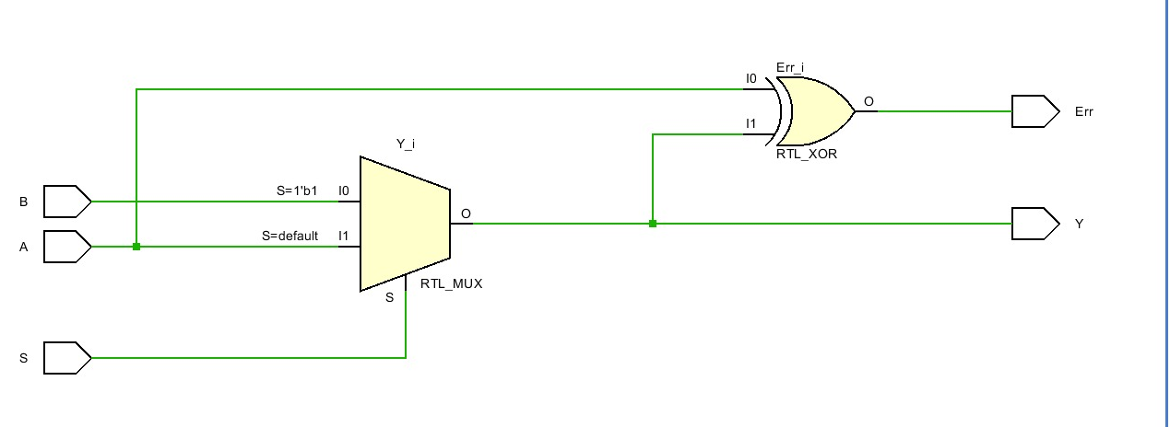
Proposed Methodology
Approach and Techniques: Truth table, 90tech gpdk
• Software: Schematic in EDA (Cadence Virtuoso)
transient analysis.
• Tools/Platforms: Cadence Virtuoso

Slide 6
Expected Outcomes
Anticipated results or deliverables:
• A CMOS 2:1 multiplexer with an integrated XOR fault detection gate capable of reliable operation at 90nm technology node, showing 2 errors i.e. on 4th and 6th half cycle.
• Enhanced fault detection capabilities that improve overall system reliability, especially in fault-sensitive environments like AI processors, FPGA systems, and quantum computing hardware.

Slide 7
Truth Table
This below is the truth table for the circuit.
A and B are the inputs and s is select line of mux.
Y(mux) is output of 2:1 mux and y(out) compares A and y(mux).
At 4th and 6th cycle it detects error, so, y(out) is 1.
A | B | S | Y(mux) | Y(out)=y(mux) xor A
0 | 0 | 0 | 0 | 0
0 | 0 | 1 | 0 | 0
0 | 1 | 0 | 0 | 0
0 | 1 | 1 | 1 | 1
1 | 0 | 0 | 1 | 0
1 | 0 | 1 | 0 | 1
1 | 1 | 0 | 1 | 0
1 | 1 | 1 | 1 | 0

Slide 8
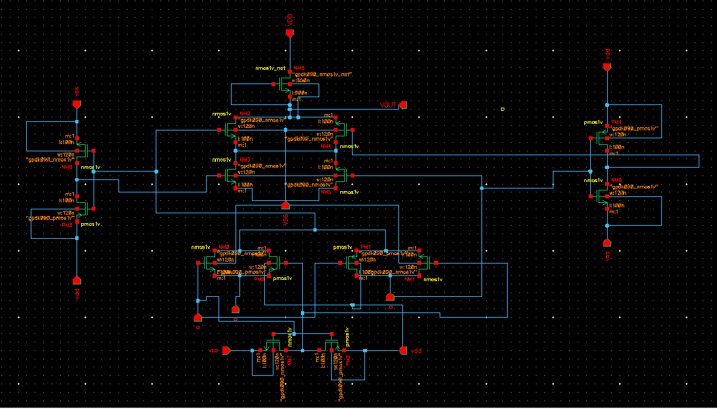
Schematic design

Slide 9
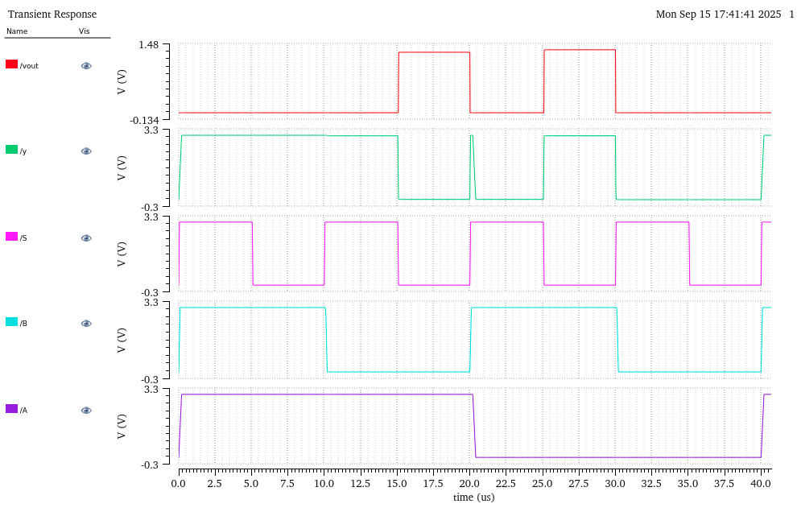
Simulation graph

Slide 10
Challenges Faced
• Integration complexity and optimization of transistor sizing to minimize delay and power overhead due to added XOR gate.
• Balancing power consumption and speed while maintaining robust fault detection using XOR integration without introducing excessive delay or signal degradation.

Slide 11
References
1. "2:1 Multiplexer Using Different Design Styles: Comparative Analysis," ICATCT 2020 Conference, Jaipur.
2. Khyati Sharma, Shweta Agrawal, "Design and Simulation of 2:1 MUX using Various CMOS logic at different technology levels," SRCEM Gwalior.

Slide 12
Thank You

